Slide 1




Vapor Pressure Difference Between H₂O and D₂O
Audrey Smith, Will Grundy, BP Blakely, Stephen Tegler,
NAU Astrophysical Materials Laboratory

Slide 2
Table of contents
01
02
03
04
Background
Experimentation
Why are we researching this topic? How is our data useful?
How is a typical experiment is ran?
Results
Next...
What did we find ?
What are the next moves?

Slide 3
01
Background

Slide 4
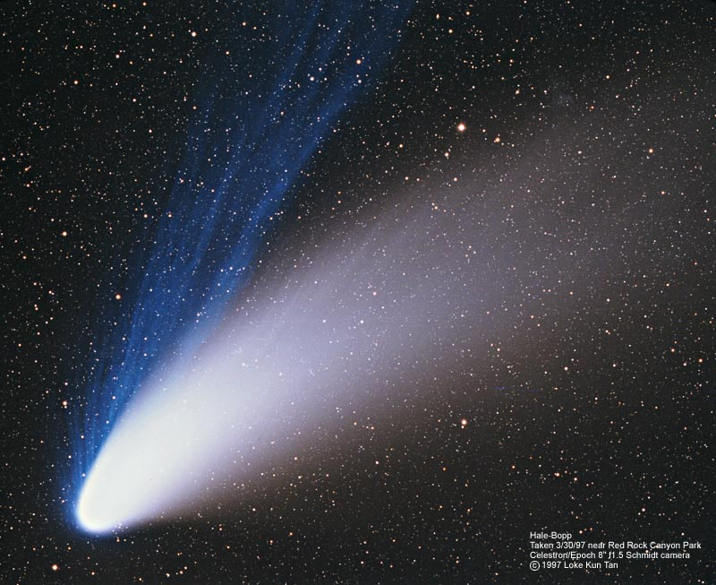
Evolution of icy bodies in the outer solar system
Comets and Kuiper Belt objects (KBOs) contain significant amounts of water ice, with varying ratios of D to H
The vapor pressure of these influences sublimation rates, outgassing processes, and deuterium-to-hydrogen (D/H) ratios.

Slide 5
02
Experimentation

Slide 6
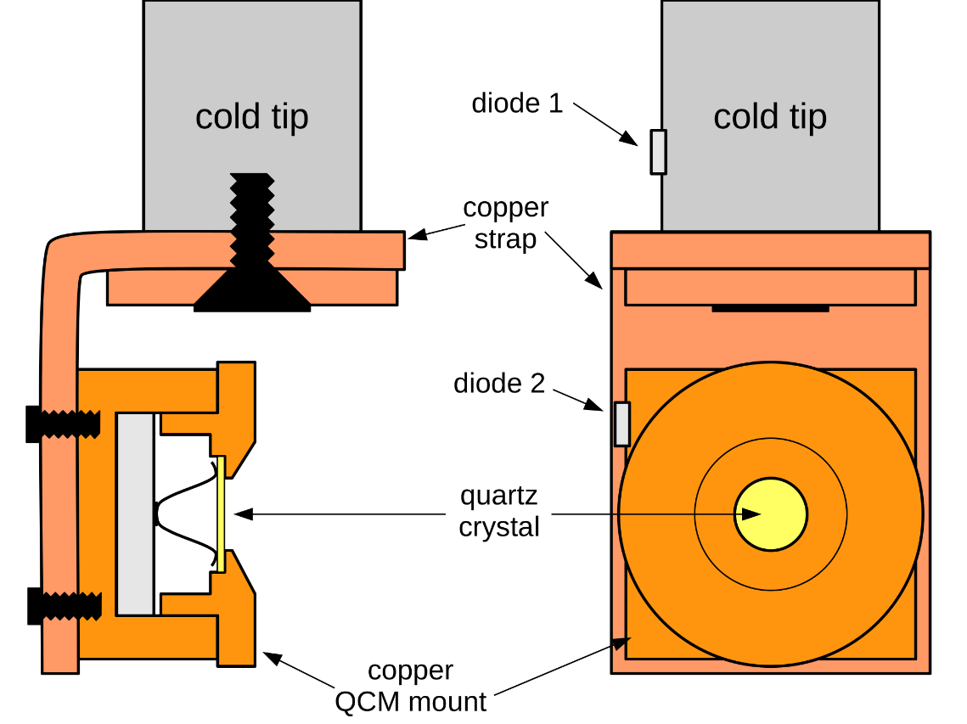
Quartz Crystal Microbalance
Can be used to measure mass via change in frequency
Useful for monitoring the rate of deposition in thin-film systems under ultra high vacuum
Gold plate is where sample is grown

Slide 7
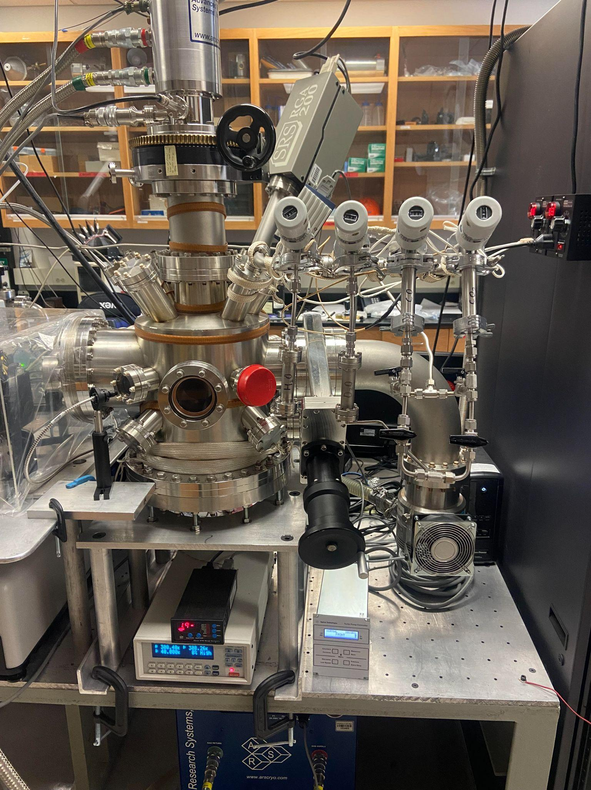
A typical experiment
Equipment used
QCM
Pressure Gauge
Temperature Control
Mass Spectrometer
Quantitative Leak Valves

Slide 8
A typical experiment
Equipment used
Set up
Deposition
QCM
Pressure Gauge
Temperature Control
Mass Spectrometer
Cool Chamber
Out gas valve to reduce pollutants
Need to grow ice thick enough
Grown at 120K
Sublimation
Heat ice to 160K
Temperature range 140-175K

Slide 9
03
Results

Slide 10
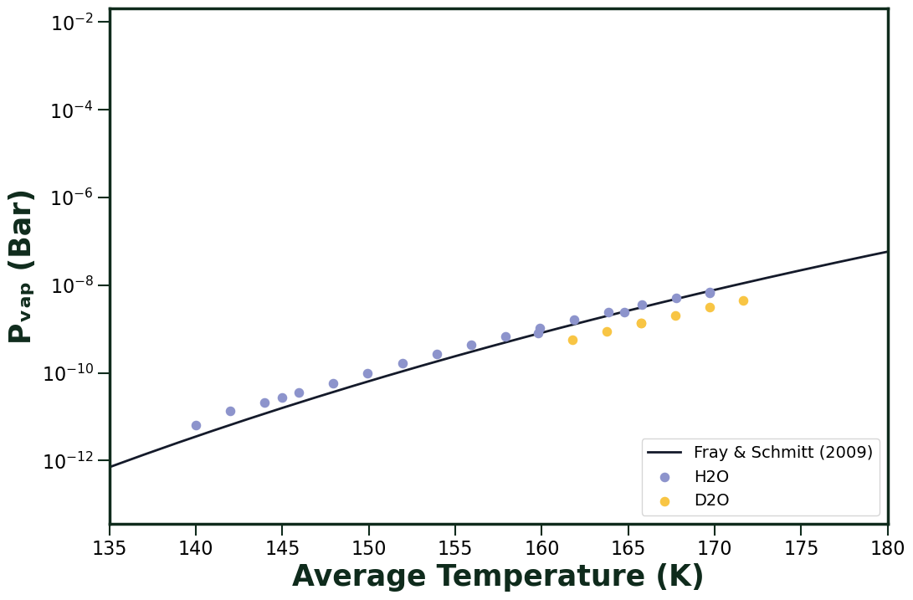
H₂O and D₂O fitted to polynomial from Fray & Schmitt (2009)
No previous vapor pressure measurement for D₂O
D₂O found to be systematically below H₂O

Slide 11
04
Next...

Slide 12
Improvements and Plans
Improve how we correct for re-condensation of vapor in the chamber
Using mass spectrometer data instead, since it can better identify which specific gases are condensing
Run experiments using water that contains heavy oxygen (¹⁸O)

Slide 13
Thanks!
Does anyone have any questions?
Please keep this slide as attribution

